Slide 1
Rethinking energy: Is it time to reinvent the wheel?
Understanding both the imperative and the opportunity
John A. “Skip” Laitner

Slide 2
Richard Feynman
In the spirit and tradition of Nobel Laureate and former Caltech physicist
Plenty of Room at the Bottom, 1959

Slide 3
Many acknowledgments
This presentation draws on the many ideas that have emerged from wide-ranging interactions and discussions with a variety of friends, colleagues, and collaborators—especially over the past couple years. In particular, I would like to acknowledge the many invaluable insights and thoughts from a broad community of “experts” and “non-experts,” including:
Stephen O. Andersen, Frank Avery, Bob Ayres, Carol Blatter, Marilyn Brown, Vera Barinova, Jim Barrett, Colette Pinchon Battle, Edith Bayer, Jeff Bennett, Ed Beshore, Jim Buizer, Clark Bullard, Liz Burke, John Byrne, Chris Calwell, Jennifer Caras, Jill Cliburn, Ken Colburn, Marine Cornelis, Doug Crockett, Courtney Crosson, Michael Crow, Jerry Dion, Jason Dispenza, Kat Donnelly, Gabrielle Dreyfus, Karen Ehrhardt-Martinez, Paul Ekins, Linda Ellinor, Janine Finnell, Steven Fawkes, Kyra Epstein, Kathleen Gaffney, Gregg Garfin, Jeff Genzer, Rick Gibson, Mark Ginsberg, Rachel Gold, Arnulf Grübler, Marca Hagenstad, DaNel Hogan, Briana Ingermann, Ely Jacobsohn, Gilets Jaunes, Henry Johnstone, Chris Juniper, Jonathan Koomey, Reiner Kümmel, Chuck Kutscher, Alice Laird, Melissa Laitner, Rob Lamb, Tatiana Lanshina, Benoît Lebot, Michael Leifman, Claude Lenglet, Debra Little, Diana Liverman, Jeff Logan, Oleg Lugovoy, Diane MacEachern, Malcolm McCulloch, Matthew McDonnell, Jim McMahon, Maggie Molina, John Morrill, Larry Morrissey, Gina Murphy-Darling, Sundarajan Mutialu, Emily Oldfield, David Osterberg, Jeremy Osowski, Michael Peel, Vladimir Postahikov, Katharine Ricke, Jeremy Rifkin, Julie Robinson, Desiree Rose, Katharine Rushton, Sofia Santos, David Schaller, Linda Silverman, Melissa Simon, Sarah Snapp, Erica Sparhawk, Victoria Steele, Janet Stephenson, Kristen Taddonio, Michael Totten, Natasha Vidangos, Suzanne Watson, Judy Weber, Meagan Weiland, Carol Werner, Rob Wilhite, Nancy Winter, and Michelle Wyman.

Slide 4
This month marks the 86th anniversary of
Black Sunday
We created The Dust Bowl drought of the 1930s – one of the worst environmental disasters of the Twentieth Century anywhere in the world.
And we’re about to do it again, only worse...

Slide 5
435th consecutive month of above average global temps
March, 2021

Slide 6
Comparing Past Perspectives and Actual Outcomes: United States (2005-2020)
$23,500 Billion GDP
~212 Million Jobs
A 2005 Standard Economic Projection
$18,400 Billion GDP
< 200 Million Jobs
The Actual Outcome
$14,900 Billion GDP
~176 Million Jobs
Source: Calculations by Laitner, using projections from EIA and other sources, March 2021.

Slide 7
Yet, there is hope...
Notes:
We solved the Dust Bowl problem then. . . (but only somewhat), yet the growing burden of Climate Change will require a more immediate, and a very big upgrade of Energy Productivity Clean Energy, and Energy Harvesting. . .Today!

Slide 8
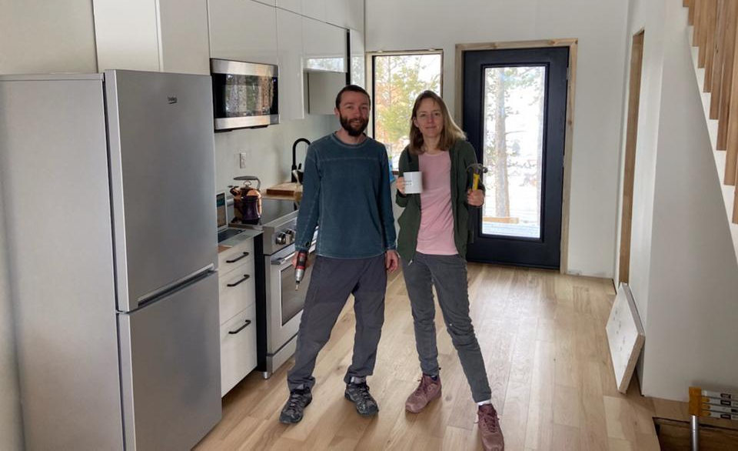
Winner of the doe solar decathlon
Congratulations CU Boulder, Kristen Taddonio and Joe Smyth

Slide 9
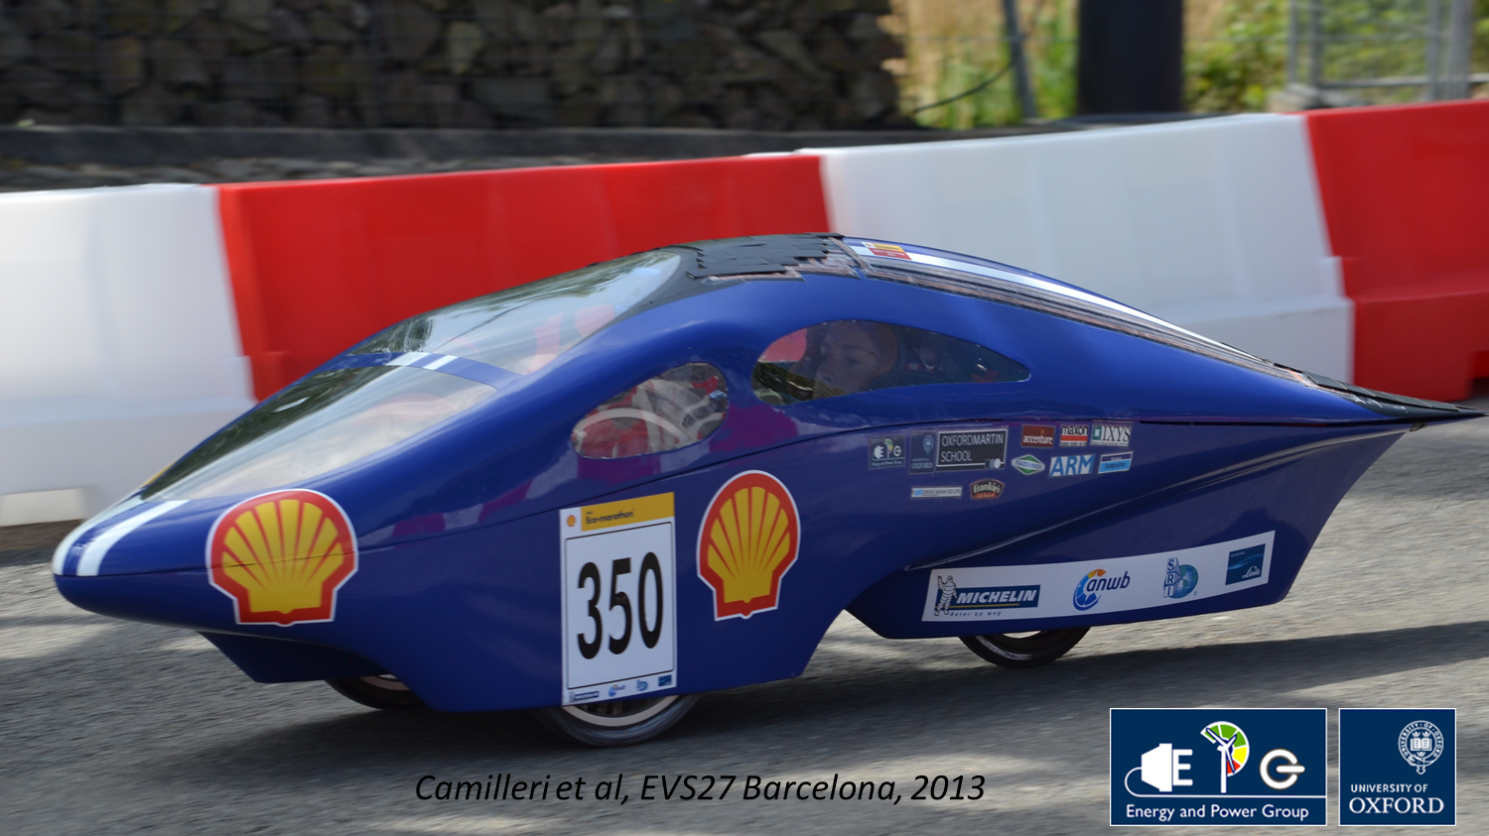

Slide 10
The brief roadmap ahead…

Slide 11
A Hard decade or A Bad century?

Slide 12
These things called energy Productivity and Energy harvesting

Slide 13
Survival of the friendliest

Slide 14
Underscoring the need for
A better narrative, dialogue and interactions that stimulate:
Imagination
Trust
A common understanding of the energy and resource imperatives
And a willingness to act today and tomorrow!

Slide 15
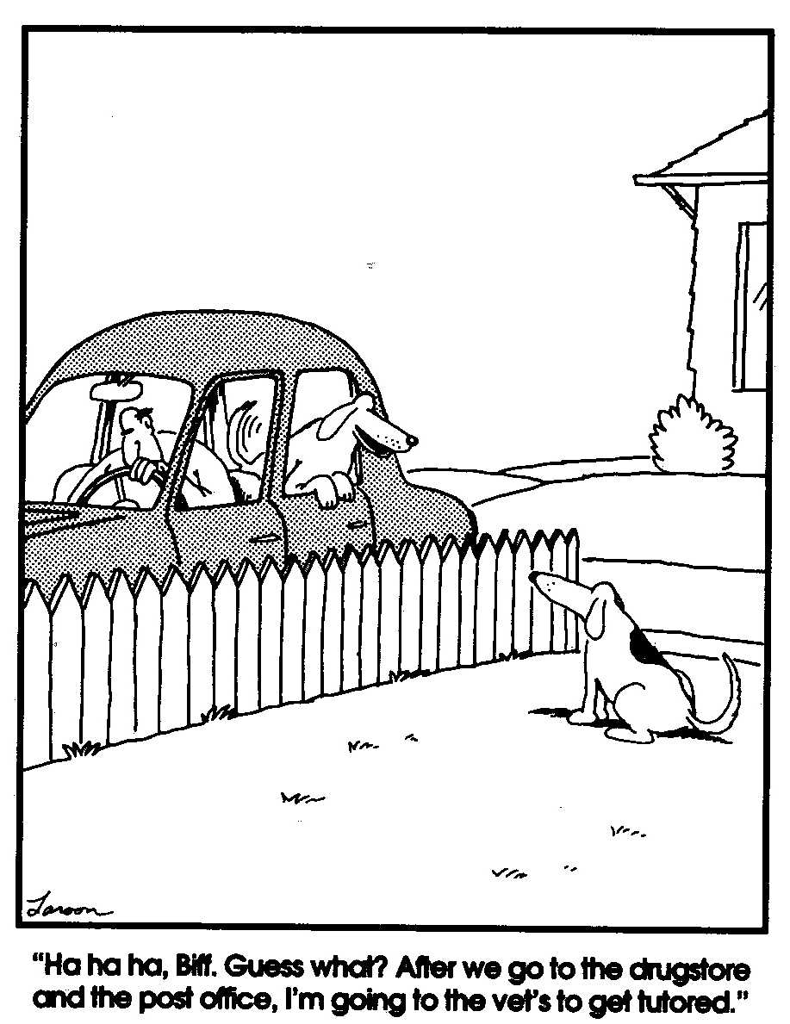
Small differences in assumptions….
Can lead to very big differences in outcomes!

Slide 16
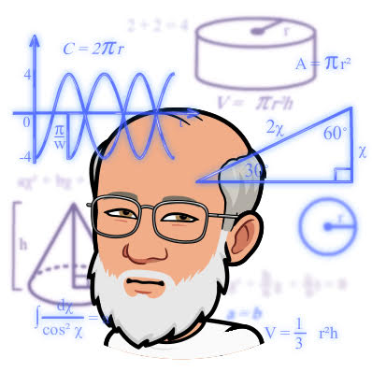
An emerging, what I call a Fermi thought experiment…

Slide 17
What is…
$4,104,594,437,832
???
Answer:
Working estimate of cumulative lost energy bill savings in the US economy since the 1992 Rio Earth Summit
By not adopting smart energy policies
averaging 3% energy productivity gains per year!
(As of about 7:00 PM MDT, 22 April 2021. . .)

Slide 18
And This Old 2001 Prius at 45 MPG?

Slide 19
If you get the same work or service out of it...
A kWh saved is so much greater than a kWh burned!

Slide 20
Types of energy losses

Slide 21
In the Production of Electricity
Change waste to 65 & 35%

Slide 22
Energy Losses in a Gasoline vehicle

Slide 23
Perhaps warranted? A different look at things. . .

Slide 24
Notes:
Report of President Truman’s Paley Commission which said solar not nuclear but, alas, we went down the nuclear and fossil fuel electricity generation path. But the “ugly duckling” is becoming now ”a beautiful swan spreads his gorgeous large wings and takes flight with the rest of its new family.”

Slide 25
What constitutes greater energy productivity?
Notes:
Yes, end-use energy efficiency;
But also the development and deployment of renewable energy technologies and systems;
And finally, much greater levels of resource productivity – whether better use of capital, materials, water, food, and especially energy.

Slide 26
What CAN greater
energy productivity ProviDe?
Notes:
A more resilient economy, more jobs, greater environmental health & social wellbeing

Slide 27
What’s this thing called energy harvesting?
Light WAVES
Kinetic Energy
Thermal Energy
And what role might it play in the future energy mix?
Radio Waves
Notes:
Energy harvesting (Also known as energy scavenging or ambient power) refers to the process of capturing and converting energy from the surroundings to electricity. The energy can either be used immediately or be stored for future use.
Types of energy harvesting
These are a few common sources of ambient energy:
Light Energy
Kinetic Energy (Vibrations, mechanical stress, etc.)
Thermal Energy
RF Energy (Radio waves)

Slide 28
Key Insight: The Energy Productivity Resource Is Larger than Generally Understood or Believed
With the question: Can “Energy Harvesting”
contribute to the greater likelihood
of a more beneficial outcome?
Typical Pre-1980 Forecasts
AEO 2005 Projection
AEO 2021 Projection
U.S. Primary Energy Use in Quads
Enabled by ICT,
New Materials,
New Technologies, & Innovative Behaviors
Catalyzed by Smart Policies,
Productive Investments, and Amplified by Energy Harvesting
Actual Historical Consumption
Low-Energy Future Based
Upon 1980 DOE Analysis and
2012 ACEEE Study
Sources: Laitner March 2021 based on DOE 1980 Policy Analysis, AER 2021, ACEEE 2012, AEO 2005, AEO 2021

Slide 29
Conventional assumptions
about the efficiency potential
Exploring the full energy productivity/energy harvesting potential: ~900 or more billion barrels of oil equivalent for the Global Economy through the year 2050.
Enough to reduce total World energy demand by ~40% or more!
MORE
BY WASTE
THAN
INGENUITY?
…an anemic ~16-19% Global energy (in)efficiency
Source: Adapted from Laitner, Smart Policies and Programs as Critical Drivers.
With the prospect for a more robust, a more resilient and a more sustainable economy. . .
Notes:
Skip to develop this as metaphor for energy harvesting

Slide 30
And Now ONto Some Specific FormS
of THIS thing called energy harvesting?

Slide 31
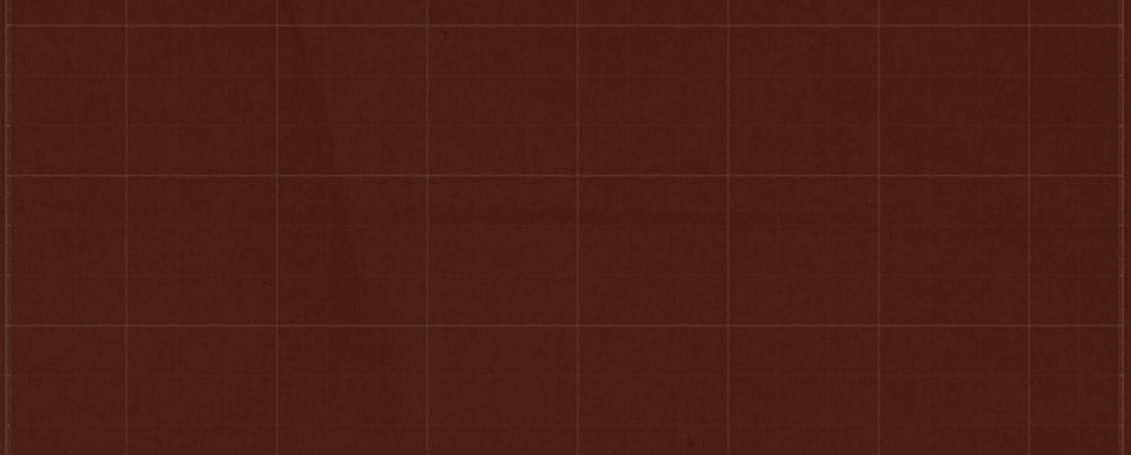
Radiative Cooling Materials
Notes:
Innovations in energy productivity:
Special materials that allow heat to radiate through the wavelength window, and vent directly back out into space, even in broad daylight with the sun beating down. It’s an entirely passive process requiring no energy input to work. Once installed these materials produce temperatures cooler than the ambient temperature around them, reducing the workload of a standard air conditioner by as much as 10 or 20 percent. A passive cooling system designed to operate beyond the dynamics of the planet itself.

Slide 33
Piezoelectric Dance Floors
Notes:
Piezoelectric floors as walking and dancing generates electricity

Slide 34
Energy Harvesting Electronics & TEXTILES
Notes:
Solar Energy Harvesting Electronic Textiles

Slide 35
agrivoltaics
Notes:
Agrivoltaics

Slide 36
FLOATOvoltaics
Notes:
Floatovoltaics

Slide 37
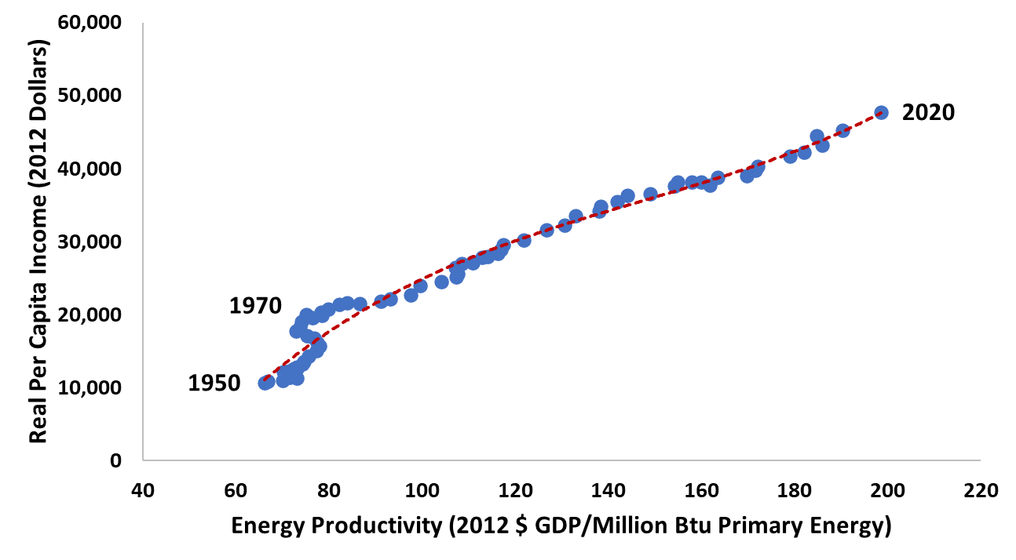
The Connection Between US Energy Productivity and Per Capita Income (1950-2020)
Source: Calculations by John A. “Skip” Laitner using US EIA-BEA data, March 2021.

Slide 38
Energy Harvesting!
Should we choose…

Slide 39
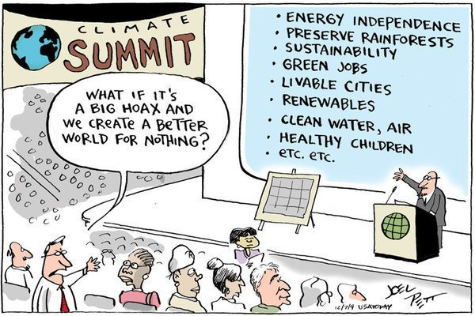

Slide 40
“Americans guess because they are in too great a hurry to think.”
– Lionel Strachey

Slide 41
“Creativity is not an escape from disciplined thinking. It is an escape with disciplined thinking.”
– Jerry Hirshberg

Slide 42
“Thinking is the hardest work there is which is the probable reason why so few engage in it.”
– Henry Ford

Slide 43
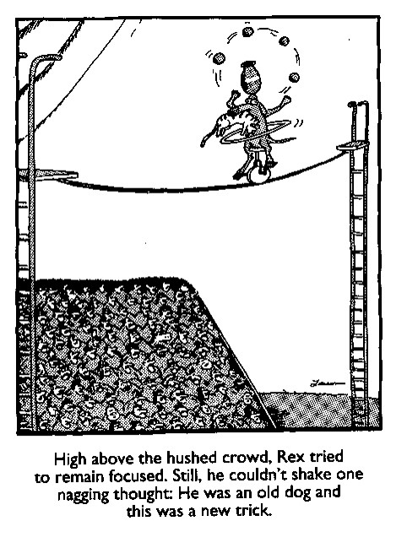
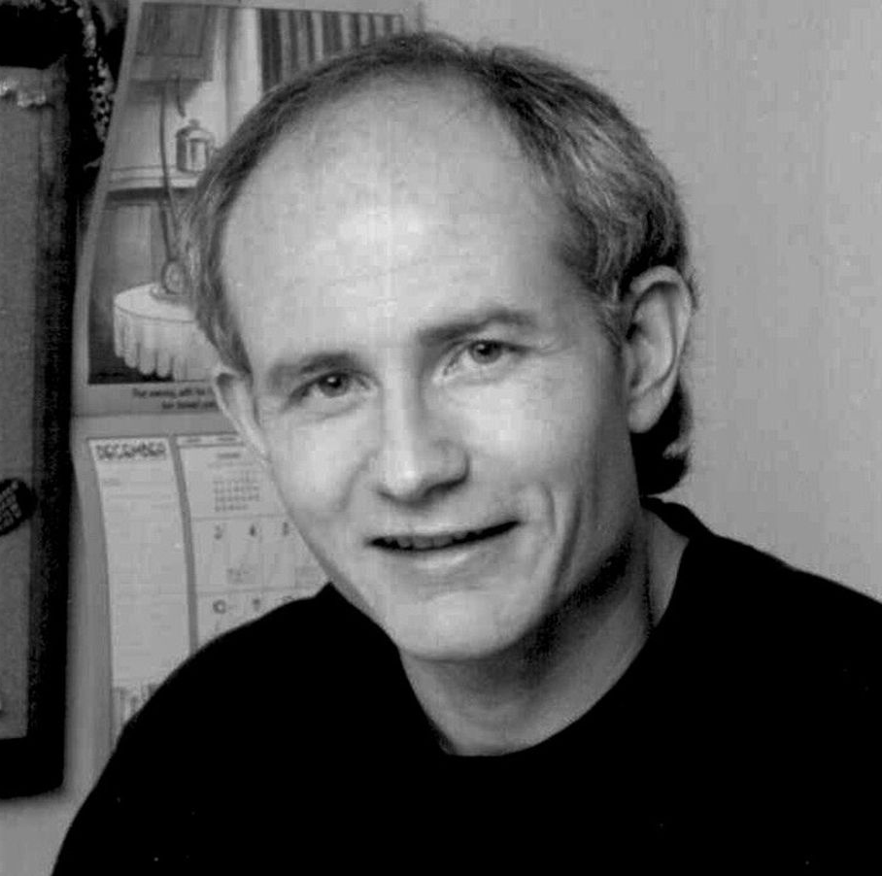
Perhaps a last word from, not my favorite physicist, but my favorite American Philosopher, Gary Larson. . .

Slide 44
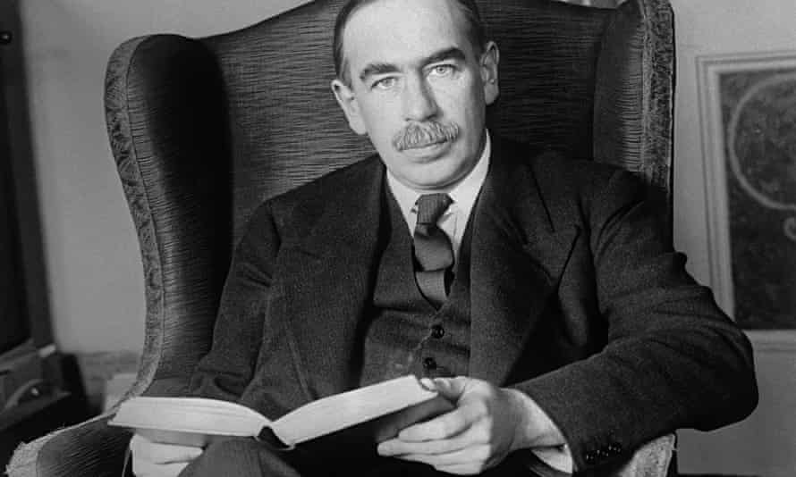
The difficulty lies not with the new ideas, but in escaping the old ones. . .
– John Maynard Keynes

Slide 45
Thank You!
Now Let’s make it happen!

