Slide 1

Institute for Applied Research
Center for Economic Modeling of Energy and Ecology
Cost and Benefits of Deep Decarbonization in Russia:
A Thought Experiment
The 7th International Symposium on Environment and Energy Finance Issues (ISEFI-2019)
Paris, France
May 24, 2019
John A. “Skip” Laitner
Senior Research Economist
E-mail: EconSkip@gmail.com
In collaboration with Oleg Lugovoy and Vladimir Potashnikov

Slide 2

Institute for Applied Research
Center for Economic Modeling of Energy and Ecology
An Opening Perspective
A Standard Working Presumption or Perception:
In both a public or lay view, and in the use of economic policy models, the assumption seems to be that the future is likely to unfold much like the recent past.
Yet, the Evidence Suggests Otherwise:
A slow erosion to our long-term social and economic well-being as suggested by lagging productivity and growth in real per capita GDP;
The clearly growing burden of climate change, together with the growth of other defensive expenditures; and
The very real and growing threat of species extinction and other ecological disruptions may further disrupt our social and economic well-being.

Slide 3
Institute for Applied Research
Center for Economic Modeling of Energy and Ecology
Stepping Back and Modeling the Production Possibilities. . .
Level of
Real GDP
Reference Case – Where We
Are Thought to be Today
Given Current
Infrastructure:
The Production
Possibilities
Frontier
Greater Environmental Quality

Slide 4
Institute for Applied Research
Center for Economic Modeling of Energy and Ecology
Stepping Back and Modeling the Production Possibilities. . .
Level of
Real GDP
Reference Case
Transition
Effect
a
b
Climate Policy Scenario
Given Current
Infrastructure:
The Production
Possibilities
Frontier
Greater Environmental Quality
Price and/or
Public
Investment

Slide 5
Institute for Applied Research
Center for Economic Modeling of Energy and Ecology
Modeling the Production Possibilities by Extending the Production Frontier. . .
A New Possibilities
Frontier with
Efficiency-led
Innovations and Infrastructure
Level of
Real GDP
d
Net Gain = Energy + Non-Energy Benefits
a
c
Transition
Effect
b
Given Current
Infrastructure:
The Production
Possibilities
Frontier
Greater Social-Environmental
Price and/or
Public
Investment
Policy & Program
Drivers
Quality Enabled by the More Productive Use of All Resources

Slide 6
Institute for Applied Research
Center for Economic Modeling of Energy and Ecology
A Thought Experiment Building on an Existing Accounting Identity
GDP = Investment + Consumption + Government Spending + Net Exports
Hence, if we can envision a set of policies and programs that:
(1) Increase overall productive investment;
(2) Generate a net savings for consumers and businesses;
(3) Provide multiple benefits from smart spending patterns; and
(4) Contribute to a net positive export balance. . . .
Then we should expect economic policy models to reflect this set of impacts. If not, then those models may not properly map the correct set of economic assumptions and outcomes.

Slide 7
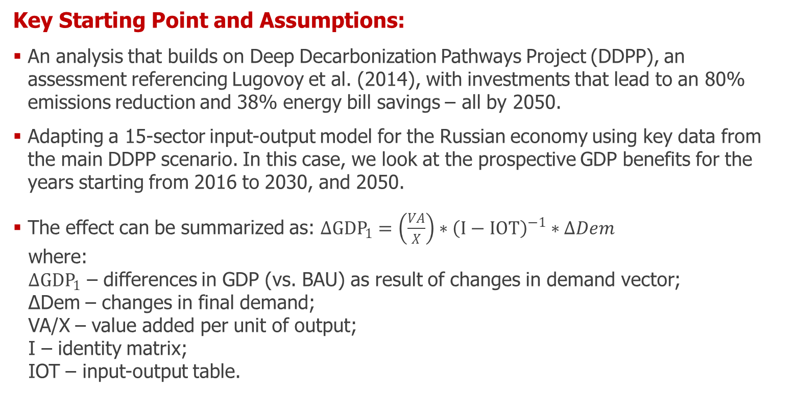
Institute for Applied Research
Center for Economic Modeling of Energy and Ecology
Methodology of the Thought Experiment – Part A
Key Starting Point and Assumptions:
An analysis that builds on Deep Decarbonization Pathways Project (DDPP), an assessment referencing Lugovoy et al. (2014), with investments that lead to an 80% emissions reduction and 38% energy bill savings – all by 2050.
Adapting a 15-sector input-output model for the Russian economy using key data from the main DDPP scenario. In this case, we look at the prospective GDP benefits for the years starting from 2016 to 2030, and 2050.
The effect can be summarized as: $ΔGDP_{1}=\left(\frac{VA}{X}\right)∗{\left(I−IOT\right)}^{−1}∗ΔDem$
where:
$ΔGDP_{1}$ – differences in GDP (vs. BAU) as result of changes in demand vector;
ΔDem – changes in final demand;
VA/X – value added per unit of output;
I – identity matrix;
IOT – input-output table.

Slide 8
Institute for Applied Research
Center for Economic Modeling of Energy and Ecology
Methodology of the Thought Experiment – Part B
Further Assumptions:
DDPP investment differences (vs. BAU) are split among the three primary groups of sectors: 30% additional demand for output of manufacturing industries; 40% of the investment demand goes to construction industries; with the remaining 30% for the import of technologies that are required to achieve full decarbonization (largely through energy efficiency and renewable energy) as well as overall modernization of the industry, but which are not yet available in the domestic market.
With the demand for new highly skilled jobs, a reduction in low-skilled jobs, and a major economic restructuring, labor productivity averages 2.5% over the scenario time horizon (Inklaar, Timmer 2013)
The demand for labor is projected to increase by 2.2 million in industry with 5.1 million in all other sectors by 2050 – an increase of 0.8% above BAU rate of labor demand.

Slide 9
Institute for Applied Research
Center for Economic Modeling of Energy and Ecology
Accumulated GDP Growth Difference, DDPP Scenario vs. BAU, in Percent

Slide 10
Institute for Applied Research
Center for Economic Modeling of Energy and Ecology
Annual Difference in GDP for the DDPP Scenario vs. BAU, Billion 2012 US$
As the Evidence Suggests:
With the more productive use of resources in the DDPP scenario, especially in the manufacturing sectors, the findings of this thought experiment indicate the annual
growth in GDP might be increased from 1.3% to 2.5% through 2050, with this likely result.
 | 2020 | 2030 | 2050 | Annual Growth
BAU | 1,781 | 1,908 | 2,661 | 1.3%
DDPP | 1,781 | 2,342 | 3,718 | 2.5%

Slide 11
Institute for Applied Research
Center for Economic Modeling of Energy and Ecology
Working Conclusions
A Technologically and Economically Feasible Outcome:
The DDPP scenario, building on Lugovoy et al. (2014), is not only feasible from a pure technology perspective, but it might actually strengthen the robustness of the Russian economy.
At the same time, however, it will require a dramatic investment and a significant structural change within the Russian economy.
Yet, at Least Three Critical Questions Remain:
How to improve both the innovation and the investment climate within Russia;
How big an effort may be needed in Russia to move from an 84% reduction in energy-related CO2 emissions to a 100% reduction of all net anthropogenic emissions by 2050; and
How big an effort will be needed to address other critical ecological burdens beyond the climate change perspective.

Slide 12
Institute for Applied Research
Center for Economic Modeling of Energy and Ecology
With a Closing Thought on the Good News
At Least Two Positive Notes on Which to Build:
First, while renewable energy technologies have gained increasing prominence as their costs have continued to decline, new studies are emerging to suggest that energy efficiency may be an even bigger cost-effective resource than previously believed. Grubler et al. (2018) and Lovins (2018), for example, indicate that energy efficiency improvements could provide 40% or more energy productivity gains compared to today’s baseline energy demands.
And as both policy makers and investors realize the scale of the potential economic returns, new studies are emerging to suggest a mix of smart policies, programs, and best energy management practices are likely to ensure the more desired social, environmental and economic outcomes. See, for example, Laitner et al. (2018).

Slide 13
Institute for Applied Research
Center for Economic Modeling of Energy and Ecology
References Cited in this Presentation
Laitner, John A. "Skip", Oleg Lugovoy, and Vladimir Potashnikov. 2019. Cost and Benefits of Deep Decarbonization in Russia: A Thought Experiment. Draft working paper. RANEPA Institute for Applied Research (the subject of this presentation).
Grubler, Arnulf, Charlie Wilson, and Nuno Bento, et al. 2018. A Low Energy Demand Scenario for Meeting the 1.5oC Target and Sustainable Development Goals without Negative Emission Technologies. Nature Energy [https://doi.org/10.1038/s41560-018-0172-6].
Inklaar, Robert and Marcel P. Timmer. 2013. Capital, Labor and TFP in PWT8.0. Groningen Growth and Development Centre, University of Groningen, July.
Laitner, John A. “Skip”, Benoît Lebot, Matthew McDonnell, and Meagan Weiland. 2018. Smart Policies and Programs as Critical Drivers for Greater Energy Efficiency Investments. Paris, France: International Partnership for Energy Efficiency Cooperation (IPEEC). https://theresourceimperative.com/2018/02/15/smart-policies-and-programs-as-critical-drivers-for-greater-energy-efficiency-investments/
Lovins, Amory B. 2018. How big is the energy efficiency resource? Environmental Research Letters 13 [DOI: https://doi.org/10.1088/1748-9326/aad965]
Lugovoy, Oleg, George Safanov, Vladimir Potashnikov, and Dmirty Gordeev. 2014. Russia Country Profile, in Pathways for Deep Decarbonization. Published by Sustainable Development Solutions Network (SDSN) and Institute for Sustainable Development and International Relations (IDDRI), September 2014. http://www.deepdecarbonization.org.

Slide 14
Спасибо за внимание!
Institute for Applied Research
Center for Economic Modeling of Energy and Ecology

