Slide 1
John A. “Skip” Laitner (@EconSkip)
In Conversation with Colleagues at the Yale School of Forestry & Environmental Studies
Yale University
April 3, 2019
Rethinking Consumption: The Economic Imperative of Resource Productivity
*
* In the spirit and tradition of Nobel Laureate and former Caltech physicist Richard Feynman, in his 1959 visionary talk, “There’s Plenty of Room at the Bottom.” See, http://www.its.caltech.edu/~feynman/plenty.html.

Slide 2

And as we are reminded by my favorite American philosopher, Gary Larson, small differences in assumptions can lead to very big differences in outcomes!!

Slide 3
An Acknowledgment
While I have benefited from a highly collegial and many interactive discussions with so many people over a long career,
I want to acknowledge my colleagues with the International Institute for Applied Systems Analysis (IIASA) and the Research Institute for Innovative Technologies for the Earth (RITE), as well as all participants in a 3-day deep-dive workshop last September in Nara, Japan,
as we then began a badly-needed collaboration and dialogue that underpins several key elements of my conversation with you here today!

Slide 4
Three Big Takeaways of Rethinking Resource Demand in Nara, Japan
Strong need for new metrics, insights, images and narratives to really help understand our social, economic, and environmental well-being – other than GDP and income alone.
Also a strong social and economic imperative of moving from merely “energy efficiency” and “renewable resources” to building greater Energy and Resource Productivity.
The social, cultural, and behavioral elements must be among the key solutions to a healthy climate and a robust and sustainable economy.

Slide 5
Exploring the Scale of Waste
If we focus only on municipal solid waste, the U.S. generates about 2 kg of waste per capita each day.
Yet, if we add to that waste, all the soil erosion, all the air pollution, all of the carbon dioxide emissions, and all the fecal matter from humans, cows and pigs, that waste grows to ~129 kg per person/day. Likely more!
Which does not include water losses, mining tailings, and the many other forms of waste in our economy.
So the question: “Are we living more by waste than ingenuity?”
And, more broadly, can the productive use of resources drive what we now call multiple benefits? I think yes!

Slide 6
With an emerging thought experiment. . .

Slide 7
Resource Impact of the Global Economy Over Time
(Real GDP as a proxy for volume of resources supporting the economy)
The scale of the 1950 global economy
The scale of the 2018 global economy
By 2050 the Cumulative Volume may be ~1,056 times the 1950 Global Economy
Cumulative impact of the global economy 1950 through 2018:
~351 times 1950 level
Example? Energy 1.6 trillion TCE ~ 80+% wasted
Living more by waste than ingenuity?

Slide 8
In Effect,
Reinvent the Wheel?
In the 1970s, teenager Frank Nasworthy actually did reinvent the wheel and it revolutionized skateboarding. . .
But that was yesterday! And today?
Goodyear is once again trying to reinvent the wheel; and if they are successful? It may eliminate the need for axles on all our cars.
Yes, sometimes we actually do need to reinvent the wheel — if we really want to move things ahead!

Slide 9
With Perhaps 3 Different Views
of the U.S. Economy

Slide 10
U.S. Trends in Real GDP Per Capita (including 1973 and 2007 inflection points)
What might this chart say about the erosion of our long-term social/economic well-being?
More critically, how might the inefficient use of energy and other resources account for a lagging economic robustness?
Source: Calculations by Laitner, based on historical GDP data from the U.S. Bureau of Economic Analysis, December 2018.

Slide 11
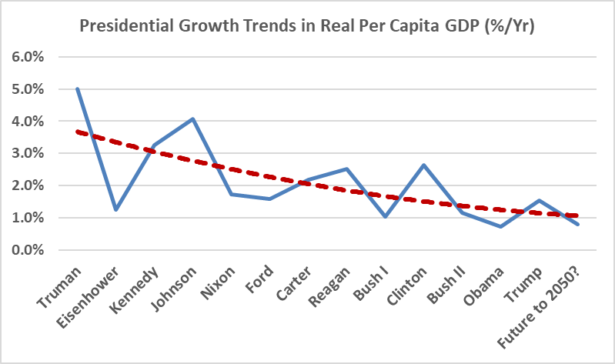
Growth Trends from Truman to Trump. . .
Three things of note. . .
(1) Average DEM growth rate: 2.6%
(2) Average GOP growth rate: 1.6%
(3) But also note a steadily declining rate… Regardless!
And how might inefficiencies further impact our economic well-being?
Source: John “Skip” Laitner, based on U.S. Energy Information Administration data 1949-2017 with Woods and Poole projections from 2018 to 2050 (December 2018).

Slide 12
What Might Constitute Greater Energy and Resource Productivity?
Yes, end-use energy efficiency;
But also the development and deployment of renewable energy technologies and systems;
And finally, much greater levels of resource productivity – whether better use of capital, materials, water, food, and especially energy.
With a question of how all this might impact our social/economic well-being?

Slide 13
The Connection Between U.S. Energy Productivity and Per Capita Income (1950-2018)
2018
1970
Given the full evidence, any thoughtful review would highlight the social and economic imperative of much greater energy and resource productivity!
1950
Source: Calculations by John A. “Skip” Laitner using EIA and BEA data for the United States, December 2018.

Slide 14
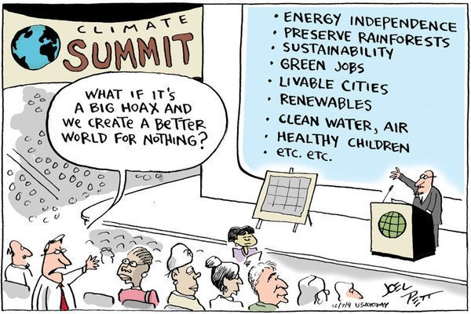
The Presumption We Need to Overcome

Slide 15
With a Thought on the Tough Choices
“Individuals have a natural tendency to choose from an impoverished option bag. Cognitive research in problem solving shows that individuals usually generate only about 30 percent of the total number of potential options on simple problems, and that, on average, individuals miss about 70 percent to 80 percent of the potential high-quality alternatives (emphasis in the original).”
Dr. Jeffrey S. Luke
Catalytic Leadership: Strategies
for an Interconnected World, 1998

Slide 16
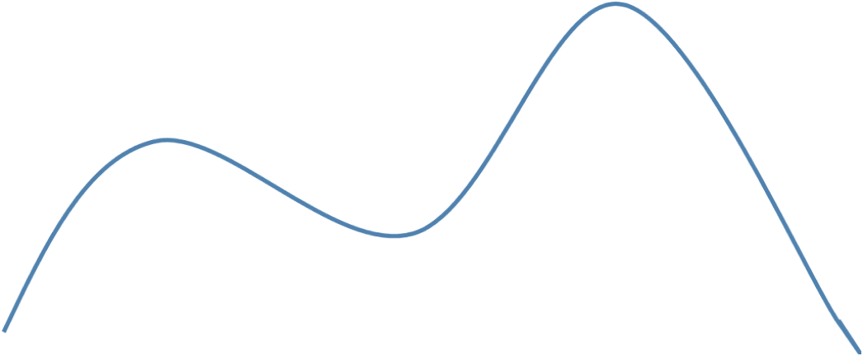
Exploring the Opportunity, Scale and
Speed of the Necessary Effort
And (4) with Energy and Resource Productivity to Underpin
Innovation Scenarios
(1) Minimum Level of Performance Required for a Robust and Sustainable U.S. Economy
(3) “An Almost There” Economy Using
Climate-Based Policies
(2) Business-As-Usual
Policies
With a need to act “at Scale,” and decidedly in “Climate Time.”

Slide 17
Key Insight: The Energy Efficiency Resource Is Larger than Generally Believed or Understood
Typical Pre-1980 Forecasts
AEO 2005 Projection
AEO 2019 Projection
U.S. Primary Energy Use in Quads
Enabled by ICT,
new materials,
new technologies,
and innovative
behaviors
Catalyzed by Smart Policies
and Productive Investments
Actual Historical Consumption
Low-Energy Future Based
Upon 1980 DOE Analysis and
2012 ACEEE Study
Sources: Laitner 2019 based on DOE 1980 Policy Analysis, ACEEE 2012, AEO 2005, AEO 2019.

Slide 18

Conventional assumptions
about the efficiency potential
Exploring the full energy efficiency potential: ~900 or more billion barrels of oil equivalent for the Global Economy through the year 2050.
Enough to reduce total World energy consumption by ~40%!
MORE
BY WASTE
THAN
INGENUITY?
With the prospect for a more robust, a more resilient and a more sustainable economy. . .
…an anemic ~16% Global energy (in)efficiency
Source: Adapted from Smart Policies and Programs as Critical Drivers. https://tinyurl.com/yb64apo7

Slide 19
With a final thought experiment . . .

Slide 20
What is. . .
$4,098,331,044,116
My working estimate of the cumulative lost energy bill savings in the U.S. economy since the 1992 Rio Earth Summit by not adopting smart energy policies averaging 3% energy productivity gains per year!
As of about 12:00 PM EDT today. . .

Slide 21
Perhaps the Ultimate Efficiency Resource
To Encourage Among Our Colleagues?
Recalling the comment of early Twentieth Century UK essayist, Lionel Strachey, who remarked: “[Too many people] guess because they are in too great a hurry to think.”
Jerry Hirschberg, founder and former CEO of Nissan Design, who noted that: “Creativity is not an escape from disciplined thinking. It is an escape with disciplined thinking."
And Henry Ford once said, “Thinking is the hardest work there is which is the probable reason why so few engage in it.”

Slide 23
The difficulty lies not with the new ideas, but in escaping the old ones. . .
John Maynard Keynes

Slide 24
Contact Information
John A. “Skip” Laitner
Principal, Resource Economist and Consultant
Economic and Human Dimensions Research Associates
Senior Research Economist
Russian Presidential Academy of National Economy and Public Administration (RANEPA)
Past-President
Association for Environmental Studies and Sciences (AESS)
Cell: +1 571 332 94 34
Email: EconSkip@gmail.com
Web: https://theresourceimperative.com/

