Slide 1
John A. “Skip” Laitner
In Conversation with EESI and Colleagues
Rethinking Energy Demand
Washington, DC
January 11, 2019
Reframing Energy for the 21st Century:
*
Understanding the Imperative of Greater Resource Productivity
* In the spirit and tradition of Nobel Laureate and former Caltech physicist Richard Feynman, in his 1959 visionary talk, “There’s Plenty of Room at the Bottom.” See, http://www.its.caltech.edu/~feynman/plenty.html.

Slide 2
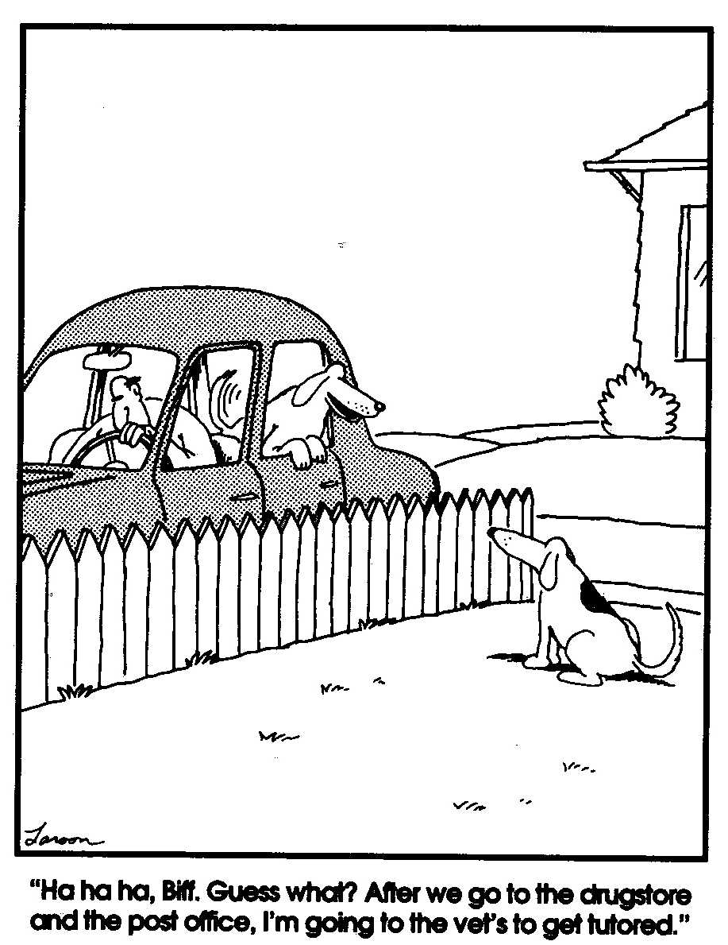
And as we are reminded by my favorite American philosopher, Gary Larson, small differences in assumptions can lead to very big differences in outcomes!!

Slide 3
At the Same Time, Acknowledgments
This presentation draws on the many ideas that have emerged from wide-ranging interactions and discussions with a variety of friends, colleagues, and collaborators—especially over the last six months. In particular, I would like to acknowledge the many invaluable insights and thoughts from a broad community of “experts” and “nonexperts,” including: Frank Avery, Bob Ayres, Carol Blatter, Marilyn Brown, Vera Barinova, Jim Barrett, Colette Pinchon Battle, Ed Beshore, Clark Bullard, Liz Burke, Jennifer Caras, Ben Champion, Aimée Christensen, Jill Cliburn, Marine Cornelis, Courtney Crosson, Michael Crow, Kat Donnelly, Karen Ehrhardt-Martinez, Paul Ekins, Linda Ellinor, Janine Finnell, Steven Fawkes, Kyra Epstein, Kathleen Gaffney, Gregg Garfin, Jeff Genzer, Rick Gibson, Arnulf Grübler, Gilets Jaunes, Henry Johnstone, Jonathan Koomey, Reiner Kümmel, Alice Laird, Melissa Laitner, Rob Lamb, Tatiana Lanshina, Benoît Lebot, Michael Leifman, Claude Lenglet, Diana Liverman, Oleg Lugovoy, Diane MacEachern, Malcolm McCulloch, Matthew McDonnell, Jim McMahon, Maggie Molina, John Morrill, Sundarajan Mutialu, Michael Nobel, David Osterberg, Vladimir Postahikov, Graham Richard, Julie Robinson, Sofia Santos, David Schaller, Linda Silverman, Melissa Simon, Erica Sparhawk, Victoria Steele, Janet Stephenson, Jenny Thorvaldson, Michael Totten, Natasha Vidangos, Suzanne Watson, Judy Weber, Meagan Weiland, Carol Werner, Rob Wilhite, Nancy Winter, Michelle Wyman, and Dan York.

Slide 4
And through these many discussions, we have emerging. . .

Slide 5
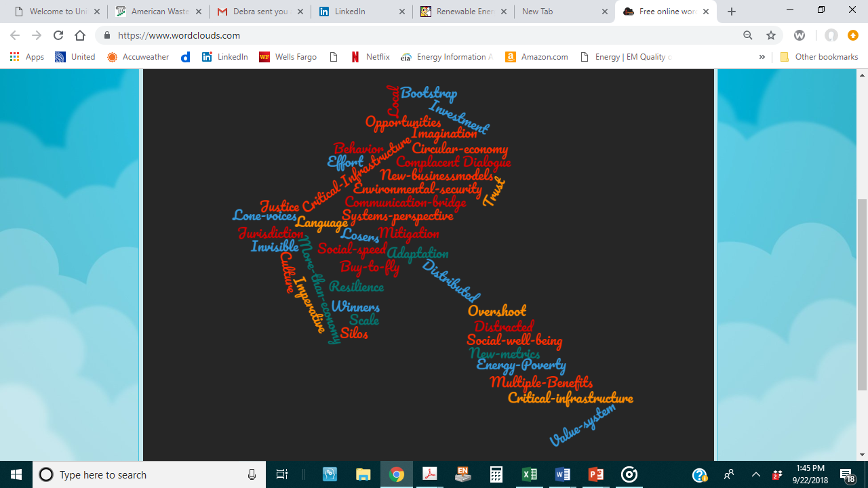
An Energy
Word
Silos
Cloud

Slide 6
Yes, Silos…
Rooted in many contexts
By culture, income, and locale
By scale and institutional perspective
By legal or regional jurisdictions
Also by discipline, job, or perceived opportunity (among many others). . .
All underscoring the need for better dialogue and interaction that stimulates imagination, and that builds trust, all with a more appropriate common understanding of the “energy/resource imperative.”
And with some of the beginnings of this discussion, I want to acknowledge my colleagues with IIASA and RITE, and all participants in a 3 day deep-dive workshop, as we began a badly-needed collaboration and dialogue!

Slide 7
Three Big Takeaways of Rethinking Energy Demand in Nara, Japan
Strong need for new metrics and insights to really understand our social, economic, and environmental well-being – other than GDP.
Given the above, a social-economic imperative of moving from merely “energy efficiency” and “renewable resources” to building greater Energy and Resource Productivity.
The social, cultural, and behavioral elements must be among the key solutions to a healthy climate and a robust and sustainable economy.

Slide 8
What is. . .
$4,010,120,735,147
My working estimate of the cumulative lost energy bill savings in the U.S. economy since the 1992 Rio Summit by not adopting smart energy policies averaging 3% energy productivity gains per year!
As of about 3:00 PM EST January 11, 2019. . .

Slide 9
Quintessential Sextet for a Robust and Sustainable Social/Economic Well-Being
Breaking out of our many silos with renewed trust and a shared vision
Negative emissions capacity
Greater resource and energy productivity
Renewable energy systems and technologies
Storage of information, energy, and resources
Information platform to manage the resources and to optimize their many possible outcomes
*
* The thing on which we will focus this talk here today. . .

Slide 10
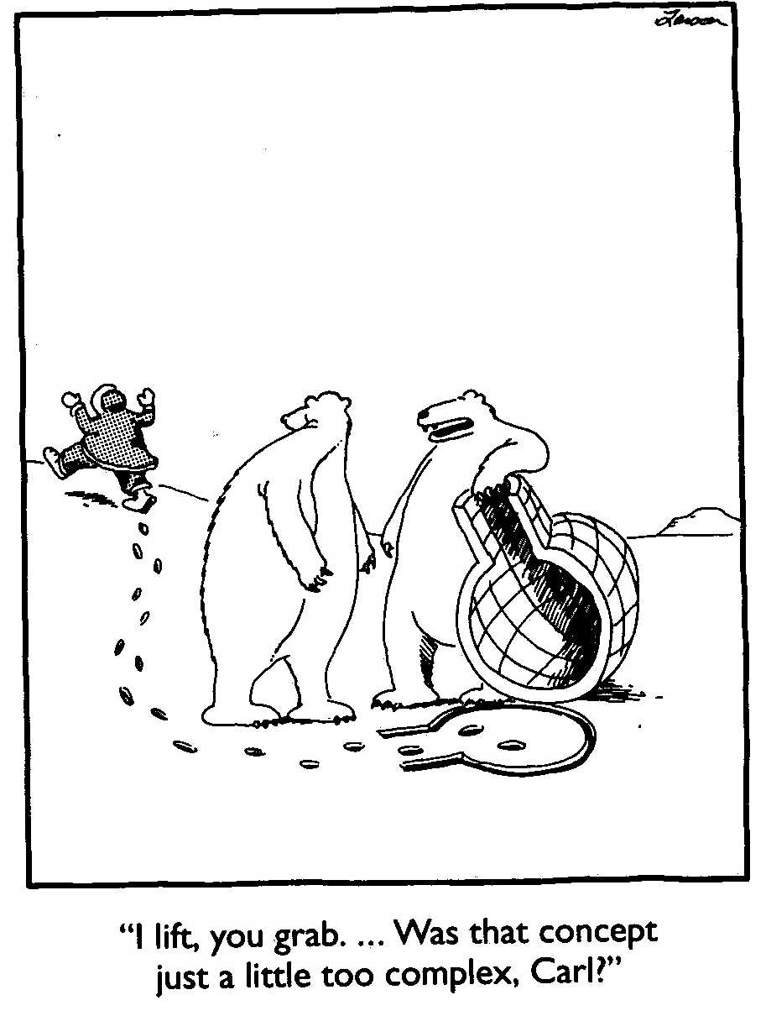
Insights from favorite American philosopher, Gary Larson
The Public?
The Sustainability Bears?
How might we explain the energy and resource complexities in ways that better connect with members of the public?

Slide 11

Question: How might the Rings of Saturn help us think about the social and economic well-being of our wasteful global community?

Slide 12
Growth of the U.S. Economy: Depending on the Way We Look at the Problem
Source: Calculations by John A. “Skip” Laitner using BEA and Moody’s forecast data for the U.S., December 2018.

Slide 13
Growth of the U.S. Economy: Depending on the Way We Look at the Problem
By no means unique to the United States, there is a similar pattern within the OECD and developing nations as well.
Source: Calculations by John A. “Skip” Laitner using BEA and Moody’s forecast data for the U.S., December 2018.

Slide 14
U.S. Trends in Real GDP Per Capita (including 1973 and 2007 inflection points)
What might this chart say about the erosion of our long-term social/economic well-being?
More critically, how might the inefficient use of energy and other resources account for a lagging economic robustness?
Source: Calculations by Laitner, based on historical GDP data from the U.S. Bureau of Economic Analysis, December 2018.

Slide 15
Comparing the Resource Impact of the U.S. Economy Over Time
(where real GDP is the volume of resources used to support the economy)
The scale of the 1950 U.S. economy
The scale of the 2018 U.S. economy
The cumulative impact of the U.S. economy over the years 1950 through 2018:
266 times 1950

Slide 16

By 2050 the Cumulative Volume will be ~632 times the 1950 Economy
The scale of the 1950 U.S. economy
The scale of the 2018 U.S. economy
The cumulative impact of the U.S. economy over the years 1950 through 2018:
266 times 1950

Slide 17
Three Intermediate Waste Perspectives
Tracking the incredible array of wastes that, unfortunately, are a very large part of our life;
Understanding energy as work; and
Exploring key linkages to our total energy and the larger resource productivity.
If we want to imagine a more robust and a more sustainable economy, we should find ways to help policy makers and business leaders step back, examine these perspectives, in depth; and then help everyone act on all three together, at scale, and with an accelerated transformation…

Slide 18
(1) The Scale of Waste in the U.S.
If we focus only on municipal solid waste, the U.S. generates about 2 kg of waste per capita each day.
Yet, if we add to that waste, all the soil erosion, all the air pollution, all of the carbon dioxide emissions, and all the fecal matter from humans, cows and pigs, that waste grows to ~127 kg per person/day. Likely more!
Which does not include water losses, mining tailings, and the many other forms of waste in our economy.
So the question: “Are we living more by waste than ingenuity?”
And, more broadly, can the productive use of resources drive what we now call multiple benefits? I think yes!

Slide 19
(2) The Different Views on Energy
Typical: Energy as commodities that are sold on the market at some price (e.g., barrels of oil or kilowatt-hours of electricity) – tracked by the various governmental agencies.
More Vital: Energy as the capacity to do the useful work necessary to transform matter into the requisite goods and services for a local economy, and to distribute or make them available as required.
Result: To ensure the appropriate development of innovation for sustainable economic activity, the emphasis needs to be on energy as work—moving well past perhaps a 16% global (in)efficiency.

Slide 20
(3) Key Energy Linkages Which Impact Overall Energy Productivity
Cost-effective energy efficiency improvements to reduce the level of end-use energy services necessary to deliver desired goods and other services.
Renewables and other clean energy production to ease primary energy requirements, also cost-effectively, in the delivery of remaining energy needs.
Shrinking the non-productive use of capital, materials, water, food and other resources to lessen energy demands even further.
All 3 categories of productivity gains—end-use efficiency, the more-efficient production from renewable energy, and waste reduction—can increase total energy productivity to benefit our social, economic and environmental well-being.

Slide 21
The Connection Between U.S. Energy Productivity and Per Capita Income (1950-2018)
2018
1970
Given the full evidence, any thoughtful review would highlight the social and economic imperative of much greater energy and resource productivity!
1950
Source: Calculations by John A. “Skip” Laitner using EIA and BEA data for the United States, December 2018.

Slide 22
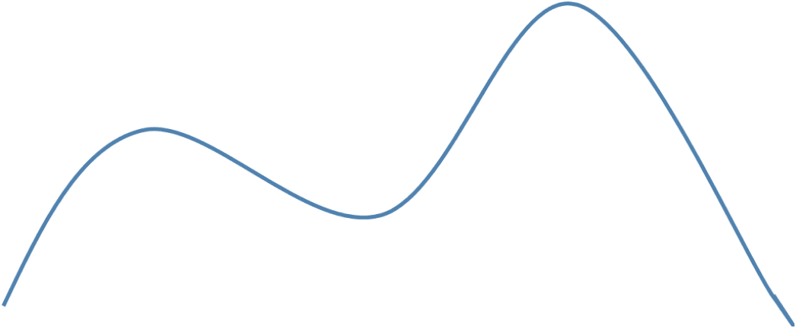
Exploring the Scale and Speed of Effort Required
And with Energy and Resource Productivity
Innovation Scenarios
Minimum Level of Performance Required for a Robust and Sustainable U.S. Economy
“An Almost There” Economy Using
Climate-Based Policies
Business-As-Usual
Policies
With a need to act “at Scale”, no longer in China Time, but in “Climate Time.”

Slide 23
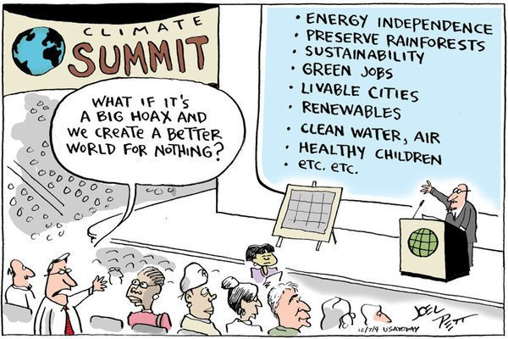
The Presumption We Need to Overcome

Slide 24
With a Thought on the Tough Choices
“Individuals have a natural tendency to choose from an impoverished option bag. Cognitive research in problem solving shows that individuals usually generate only about 30 percent of the total number of potential options on simple problems, and that, on average, individuals miss about 70 percent to 80 percent of the potential high-quality alternatives (emphasis in the original).”
Dr. Jeffrey S. Luke
Catalytic Leadership: Strategies
for an Interconnected World, 1998

Slide 25
Given That?
Reinvent the Wheel??
In the 1970s, teenager Frank Nasworthy actually did reinvent the wheel and it revolutionized skateboarding. . .
But that was yesterday! And today?
Goodyear is once again trying to reinvent the wheel; and if they are successful? It may eliminate the need for axles on all our cars.
Yes, sometimes we actually do need to reinvent the wheel — if we really want to move things ahead!

Slide 26
Since 1950
Energy Efficiency Met 64% of Total U.S. Demand for Energy Services (73% of New) While Energy Supply Only 35% (27% New)
Year 2018 Index = 811
New Value-Added
Energy
Efficiency Gains
Energy Efficiency
Met 64% of Total Demand for Energy Services
New Supply
Energy Supplies
Met 36% of Total Demand for Energy Services
Index 1950 = 100
Base
Base
1950 Level
1950 Level
GDP
Energy
GDP
Energy
Source: John A. “Skip” Laitner based on U.S. Energy Information Administration Data, January 2019.

Slide 27
Key Insight: The Energy Efficiency Resource Is Larger than Generally Believed or Understood
Typical Pre-1980 Forecasts
AEO 2005 Projection
AEO 2018 Projection
U.S. Primary Energy Use in Quads
Enabled by ICT, new materials, new technologies, and innovative behaviors
Catalyzed by Smart Policies
and Productive Investments
Actual Historical Consumption
Low-Energy Future Based
Upon 1980 DOE Analysis and
2012 ACEEE Study
Sources: Laitner 2018, based on DOE 1980 Policy Analysis, ACEEE 2012, AEO 2005, AEO 2018.

Slide 28

Conventional assumptions
about the efficiency potential
Exploring the full energy efficiency potential: ~900 or more billion barrels of oil equivalent for the Global Economy through the year 2050.
Enough to reduce total World energy consumption by ~40%!
MORE
BY WASTE
THAN
INGENUITY?
With the prospect for a more robust, a more resilient and a more sustainable economy. . .
…an anemic ~16% Global energy (in)efficiency
Source: Adapted from Smart Policies and Programs as Critical Drivers. https://tinyurl.com/yb64apo7

Slide 29
How Smart Programs and Policies Might Drive Global Savings
Source: Laitner et al. (2018) for IPEEC: Smart Policies and Programs as Critical Drivers. https://tinyurl.com/yb64apo7

Slide 30
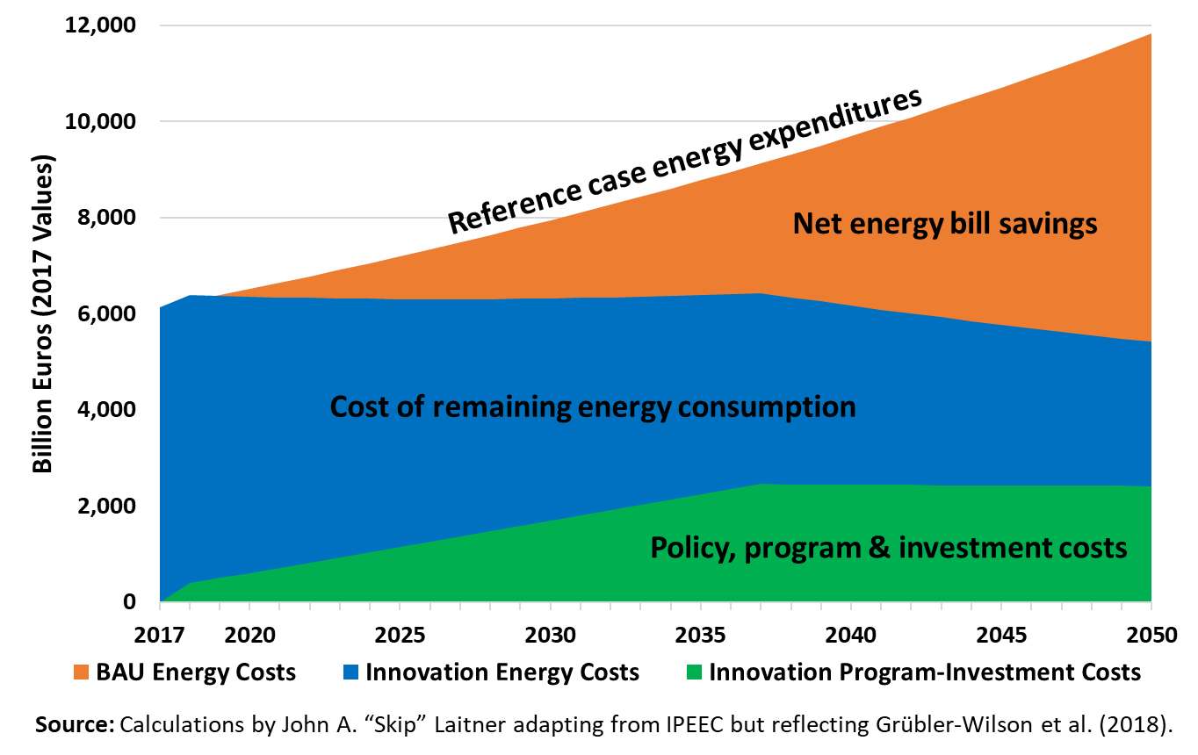
How a Grübler-Wilson et al. Scenario Might Drive Savings

Slide 31
Perhaps the Ultimate Efficiency Resource
To Encourage Among Our Colleagues?
Recalling the comment of early Twentieth Century UK essayist, Lionel Strachey, who remarked: “[Too many people] guess because they are in too great a hurry to think.”
Jerry Hirschberg, founder and former CEO of Nissan Design, who noted that: “Creativity is not an escape from disciplined thinking. It is an escape with disciplined thinking."
And Henry Ford once said, “Thinking is the hardest work there is which is the probable reason why so few engage in it.”

Slide 33
The difficulty lies not with the new ideas, but in escaping the old ones. . .
John Maynard Keynes

Slide 34
Contact Information
John A. “Skip” Laitner
Principal, Resource Economist and Consultant
Economic and Human Dimensions Research Associates
Senior Research Economist
Russian Presidential Academy of National Economy and Public Administration (RANEPA)
Past-President
Association for Environmental Studies and Sciences (AESS)
Cell: +1 571 332 94 34
Email: EconSkip@gmail.com
Web: https://theresourceimperative.com/

