Slide 1
John A. “Skip” Laitner
In Conversation with the Alliance to Save Energy and Other Colleagues
Rethinking Energy Demand
Washington, DC
December 6, 2018
Reframing Energy for the 21st Century:
*
Understanding the Imperative of Greater Energy Productivity
* In the spirit and tradition of Nobel Laureate and former Caltech physicist Richard Feynman, in his 1959 visionary talk, “There’s Plenty of Room at the Bottom.” See, http://www.its.caltech.edu/~feynman/plenty.html.

Slide 2
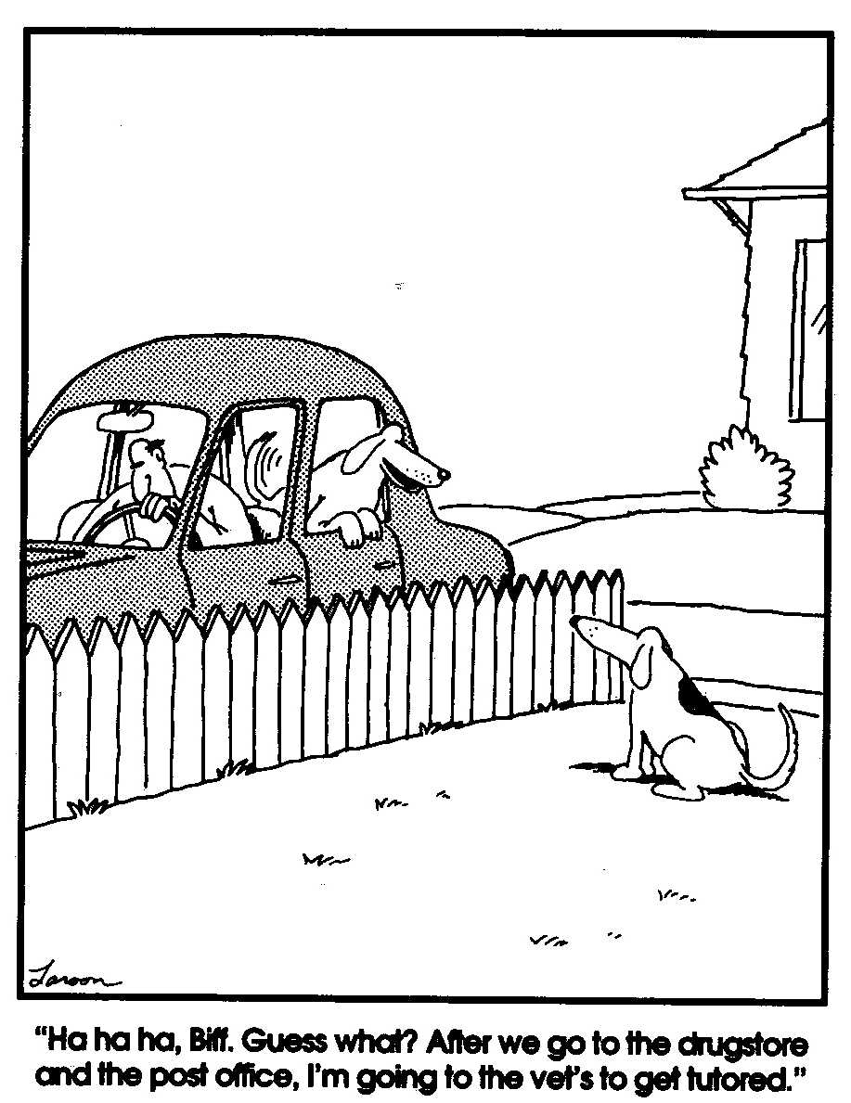
And as we are reminded by my favorite American philosopher, Gary Larson, small differences in assumptions can lead to very big differences in outcomes!!

Slide 3
The Roadmap Ahead
Acknowledgements, silos and reinventing the wheel
Exploring the economic imperative of greater energy and resource productivity
Examining purposeful efforts as they drive productive investments
Reviewing immediate but (unfortunately) still emerging prospects. . .

Slide 4
Yes, Some Acknowledgments
This presentation draws on the many ideas that have emerged from wide-ranging interactions and discussions with a variety of friends, colleagues, and collaborators—especially over the last four months. In particular, I would like to acknowledge the many invaluable insights and thoughts from a broad community of experts and nonexperts, including: Frank Avery, Bob Ayres, Marilyn Brown, Vera Barinova, Colette Pinchon Battle, Ed Beshore, Clark Bullard, Ben Champion, Aimée Christensen, Jill Cliburn, Marine Cornelis, Courtney Crosson, Michael Crow, Kat Donnelly, Karen Ehrhardt-Martinez, Paul Ekins, Linda Ellinor, Neal Elliot, Janine Finnell, Sue Futrell, Kyra Epstein, Kathleen Gaffney, Gregg Garfin, Jeff Genzer, Rick Gibson, Arnulf Grübler, Jason, Hartke, Wendolyn Holland, Jonathan Koomey, Reiner Kümmel, Alice Laird, Melissa Laitner, Rob Lamb, Sharon Lake, Tatiana Lanshina, Benoît Lebot, Michael Leifman, Claude Lenglet, Diane MacEachern, Malcolm McCulloch, Matthew McDonnell, Jim McMahon, Maggie Molina, Sundarajan Mutialu, Michael Nobel, David Osterberg, Vladimir Postahikov, Graham Richard, Julie Robinson, Sofia Santos, David Schaller, Linda Silverman, Melissa Simon, Erica Sparhawk, Victoria Steele, Janet Stephenson, Jenny Thorvaldson, Michael Totten, Scott Valentine, Suzanne Watson, Meagan Weiland, Judy Weber, Carol Werner, Michelle Wyman, and Dan York.

Slide 5
And through these many discussions, we have emerging. . .

Slide 6
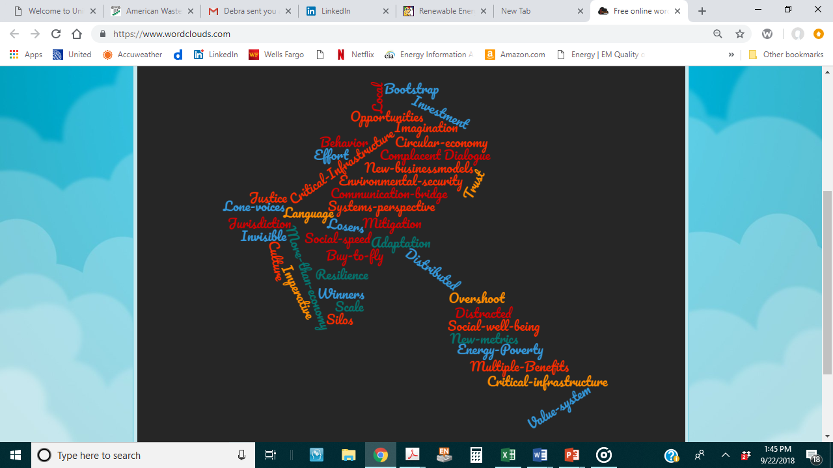
An Energy
Word
Silos
Cloud

Slide 7
Yes, Silos…
Rooted in many contexts
By culture and locale
By scale and institutional perspective
By legal or regional jurisdictions
Also by discipline, job, or perceived opportunity (among many others). . .
All underscoring the need for better dialogue and interaction, that stimulates imagination, that builds trust, all with a more appropriate common understanding of the “energy resource imperative” and a shared vision for the future.
Especially thanking IIASA, RITE, and all participants in a critical and collaborative 3-day, deep-dive in Nara, Japan that begins a serious effort to “Rethink Energy Demand.”

Slide 8
Now What?
Reinvent the Wheel???
In the 1970s, teenager Frank Nasworthy actually did reinvent the wheel and it revolutionized skateboarding. . .
But that was yesterday! And today?
Goodyear is once again trying to reinvent the wheel; and if they are successful? It may eliminate the need for axles on all our cars.
Yes, sometimes we actually do need to reinvent the wheel — if we really want to move things ahead!

Slide 9
With a Complementary Perspective
Compelling evidence that economy-wide returns on the current infrastructure and technologies are diminishing.
A social and economic transformation is clearly needed – driven by “purposeful efforts” that include fully funded programs, directed actions, and much more “productive investments.”
The interactive, productive, and more efficient use of all resources—capital, materials, food, water, and especially energy—must underpin this transformation.
There is further a need to better understand/assess key social and economic trends to shape a policy-directed transition which also promotes environmental quality.

Slide 10
Key Insight: The Energy Efficiency Resource Is Larger than Generally Believed or Understood
Typical Pre-1980 Forecasts
AEO 2005 Projection
AEO 2018 Projection
U.S. Primary Energy Use in Quads
Enabled by ICT, new materials, new technologies, and innovative behaviors
Catalyzed by Smart Policies
and Productive Investments
Actual Historical Consumption
Low-Energy Future Based
Upon 1980 DOE Analysis and
2012 ACEEE Study
Sources: Laitner 2018, based on DOE 1980 Policy Analysis, ACEEE 2012, AEO 2005, AEO 2018.

Slide 11

Conventional assumptions
about the efficiency potential
Exploring the full energy efficiency potential: ~900 or more billion barrels of oil equivalent for the Global Economy through the year 2050.
Sufficient to reduce total World energy consumption by ~40%!
MORE
BY WASTE
THAN
INGENUITY?
With the prospect for a more robust, a more resilient and a more sustainable economy. . .
…an anemic ~16% Global energy (in)efficiency
Source: Adapted from Smart Policies and Programs as Critical Drivers. https://tinyurl.com/yb64apo7

Slide 12
Three Intermediate Perspectives
Tracking the incredible array of wastes that, unfortunately, are a very large part of our life;
Understanding energy as work; and
Exploring key linkages to our total energy and the larger resource productivity.
If we want to imagine a more robust and a more sustainable economy, we should find ways to help policy makers and business leaders step back, examine these perspectives, in depth; and then help everyone act on all three together, at scale, and with an accelerated transformation…

Slide 13
(1) The Scale of Waste in the U.S.
If we focus only on municipal solid waste, the U.S. generates about 2 kg of waste per capita each day.
Yet, if we add to that waste, all the soil erosion, all the air pollution, all of the carbon dioxide emissions, and all the fecal matter from humans, cows and pigs, that waste grows to ~129 kg per person/day. Likely more!
Which does not include water losses, mining tailings, and the many other forms of waste in our economy.
So the question: “Are we living more by waste than ingenuity?”
And, more broadly, can the productive use of resources drive what we now call multiple benefits? I think yes!

Slide 14
(2) The Different Views on Energy
Typical: Energy as commodities that are sold on the market at some price (e.g., barrels of oil or kilowatt-hours of electricity) – tracked by the various governmental agencies.
More Vital: Energy as the capacity to do the useful work necessary to transform matter into the requisite goods and services for a local economy, and to distribute or make them available as required.
Result: To ensure the appropriate development of innovation for sustainable economic activity, the emphasis needs to be on energy as work—moving well past perhaps a 16% global (in)efficiency.

Slide 15
(3) Key Energy Linkages Which Impact Overall Energy Productivity
Cost-effective energy efficiency improvements to reduce the level of end-use energy services necessary to deliver desired goods and other services.
Renewables and other clean energy production to ease primary energy requirements, also cost-effectively, in the delivery of remaining energy needs.
Shrinking the non-productive use of capital, materials, water, food and other resources to lessen energy demands even further.
All 3 categories of productivity gains—end-use efficiency, the more-efficient production from renewable energy, and waste reduction—can increase total energy productivity to benefit our social, economic and environmental well-being.

Slide 16
The Connection Between U.S. Energy Productivity and Per Capita Income (1950-2018)
2018
1970
Given the full evidence, any thoughtful review would highlight the social and economic imperative of much greater energy and resource productivity!
1950
Source: Calculations by John A. “Skip” Laitner using EIA and BEA data for the United States, May 2018.

Slide 17
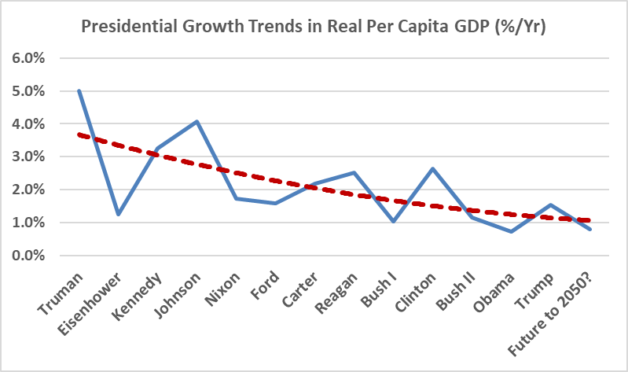
Growth Trends from Truman to Trump. . .
Three things of note. . .
(1) Average DEM growth rate: 2.6%
(2) Average GOP growth rate: 1.6%
(3) But also note a steadily declining rate… Regardless!
And how might inefficiencies further impact our economic well-being?
Source: John “Skip” Laitner, based on U.S. Energy Information Administration data 1949-2017 with Woods and Poole projections from 2018 to 2050 (December 2018).

Slide 18
How Smart Programs and Policies Might Drive Global Savings
Source: Laitner et al. (2018) for IPEEC: Smart Policies and Programs as Critical Drivers. https://tinyurl.com/yb64apo7

Slide 19
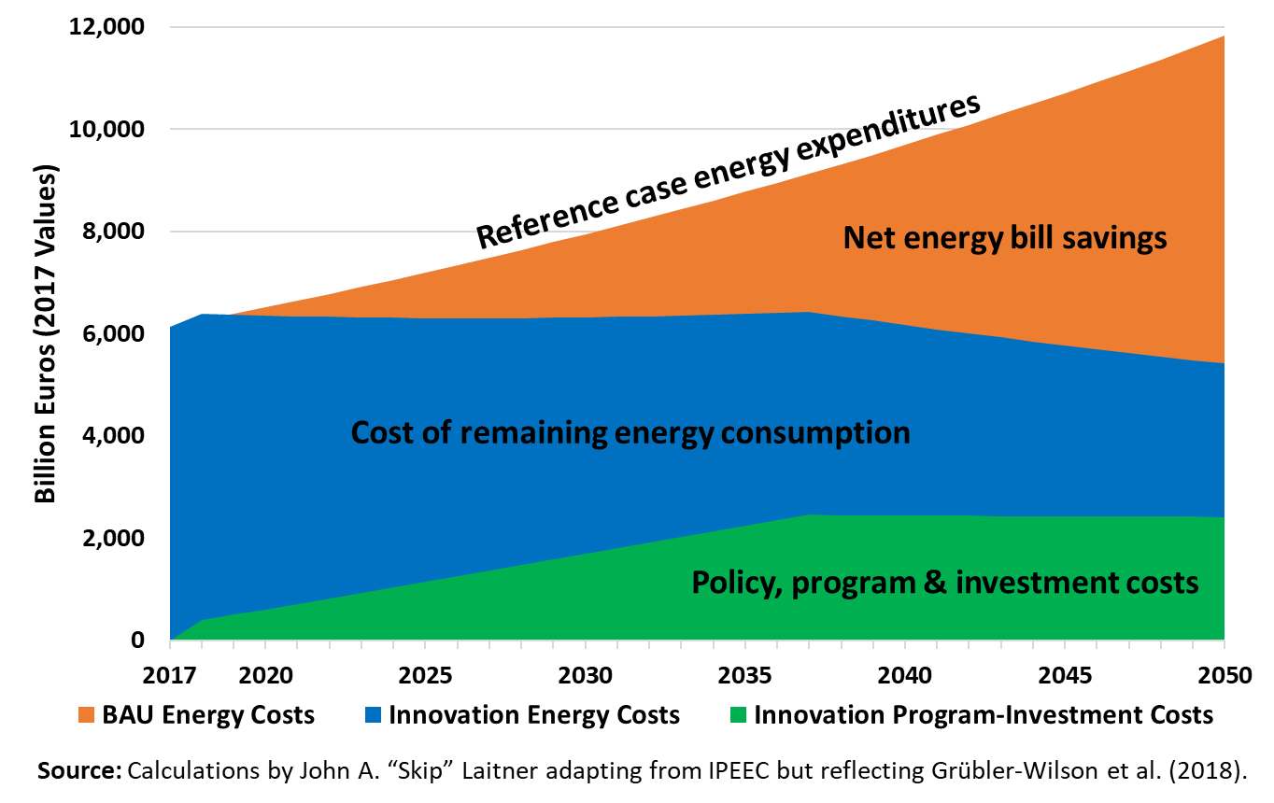
How a Grübler-Wilson et al. Scenario Might Drive Savings

Slide 20
With Immediate Steps Forward:
A Short Commentary. . .
Establishing a “purposeful effort/productive investment glidepath” as we work in:
Opportunity Zones;
Small to medium-sized communities;
Larger metropolitan areas; and finally
Both the U.S. and global economies!
At Scale and in China Time. . .

Slide 21
Perhaps the Ultimate Efficiency Resource
To Encourage Among Our Colleagues?
Recalling the comment of early Twentieth Century UK essayist, Lionel Strachey, who remarked: “[Too many people] guess because they are in too great a hurry to think.”
Jerry Hirschberg, founder and former CEO of Nissan Design, who noted that: “Creativity is not an escape from disciplined thinking. It is an escape with disciplined thinking."
And Henry Ford once said, “Thinking is the hardest work there is which is the probable reason why so few engage in it.”

Slide 22
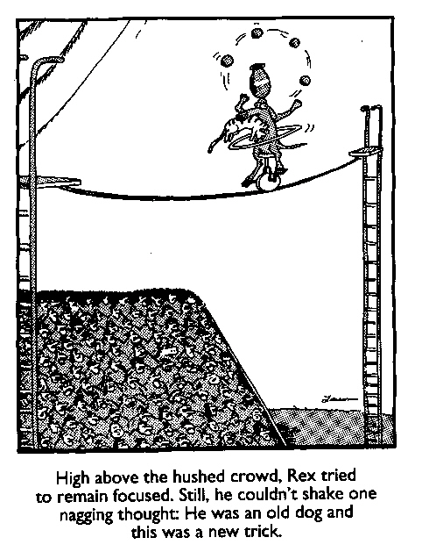

Slide 23
The difficulty lies not with the new ideas, but in escaping the old ones. . .
John Maynard Keynes

Slide 24
Contact Information
John A. “Skip” Laitner
Principal, Resource Economist and Consultant
Economic and Human Dimensions Research Associates
Senior Research Economist
Russian Presidential Academy of National Economy and Public Administration (RANEPA)
Past-President
Association for Environmental Studies and Sciences (AESS)
Cell: +1 571 332 94 34
Email: EconSkip@gmail.com
Web: https://theresourceimperative.com/

