Slide 1
John A. “Skip” Laitner In Conversation with the Canon Institute for Global Studies Tokyo, Japan September 20, 2017
Vision for Significant ICT Reduction of CO₂
*
The Economic Imperative of Information Technologies
* In the spirit and tradition of Nobel Laureate and former Caltech physicist Richard Feynman, in his 1959 visionary talk, “There’s Plenty of Room at the Bottom.” See, http://www.its.caltech.edu/~feynman/plenty.html.

Slide 2
“We shape the world by the questions we ask”
Physicist John Wheeler

Slide 3
An Opening Perspective. . .
There is clear evidence that the economy-wide returns on the “Second Industrial Revolution” technologies, and the larger public infrastructure, are diminishing.
A social and economic transformation is clearly needed – driven by purposeful effort that includes directed actions and targeted investments.
The interactive, productive, and more efficient use of all resources, especially energy, must underpin this transformation over the next decades.
Hence, the development of Third Industrial Revolution (TIR) Strategic Plans enabled by information and communication technologies (ICT).

Slide 4
With this Added Context
In his best-selling books, my colleague Jeremy Rifkin notes that any time we have the coming together of a new form of communication with a new form of energy, we have the foundation for an industrial revolution:
The First Industrial Revolution – roughly corresponding to use of print media and coal/steam energy;
The Second Industrial Revolution – telegraph and telephone coupled with the internal combustion engine and electricity generation; and
The emerging (but not at all guaranteed) Third Industrial Revolution?
A buildout of the digital infrastructure, relying on interactive communication and distributed clean energy technologies anchored by large-scale energy productivity improvements.

Slide 5
Who Is Acting, and How, on These Ideas?
Both Luxembourg (population 576,000) and MRDH (Metropolitan Region Rotterdam/Den Haag 2.3 million). . .
Working with Rifkin, and partners at Navigant Consulting and Fraunhofer Institute, we crafted ICT-led strategic plans (Roadmap Next Economy) that would dramatically increase energy productivity through 2050. With remaining energy needs provided by renewable resources.
Including significant upgrades for: (i) digital as well as the public infrastructure, (ii) energy efficiency end-uses, and (iii) the deployment of renewable energy technologies, by 2050, the plans anticipate a cumulative investment roughly equal to one year’s GDP.
The result can be a more interactive, resilient, robust, and sustainable economy that increases the net gains in jobs.

Slide 6
Motivating Factor: The Energy Productivity Link as it Increases the Per Capita GDP for MRDH
ICT-Enhanced
Industrial Infrastructure
Current Industrial Infrastructure
As this perspective might also inform other national or regional economies

Slide 7
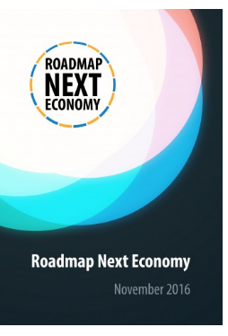
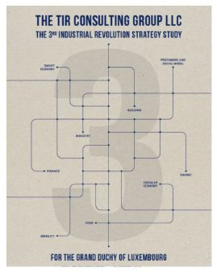
Elevating to a
Higher Level of Economic Performance
MRDH and Luxembourg:
‘Our world is in transition. We no longer live in an era of change, but are witnessing the change of an era. We are on the verge of the greatest social and economic challenge since the 19th century. Global trends like climate change, geopolitical changes, increasing migration, growing inequality, natural resource depletion (lagging rates of resource productivity) and the emergence of disruptive technological innovations are driving the transition to a systemic change. We need to anticipate this change that will fundamentally alter the way we manage, power and move our society.’
MRDH Roadmap Next Economy, February 2017
‘Today, a transition toward the Third Industrial Revolution is underway, and Luxembourg is the first country to get prepared at the national level. During the forum, different parts of the Grand Duchy’s national strategy will allow you to discover how the country enrolls in the co-construction of this new sustainable economic model.’
IMS Luxembourg, November 2016

Slide 8
The Idea of ICT-Enabled Technology
ICT consists of interactive hardware & software systems, real-time analytics and communications, designed to achieve a set of specific outcomes.
Three emerging developments (not part of GeSI 2030):
Blockchain: a distributed electronic ledger;
The Physical Internet: an open global logistics system founded on physical, digital, and operational interconnectivity;
Cloud Computing/Network-based Performing: an evolving connectivity platform.
All with an emphasis on an integrated policy, program, and planning perspective that pulls these many diverse elements into a common vision or focus.
An action plan to ensure a Roadmap Next Economy.

Slide 9
Sources of Support for These Ideas
Major assessments such as the GeSI Smarter 2030 report;
The many other university, think-tank or company-sponsored ideas and analytics; and
All combined with an emphasis on integrated policy and planning perspectives that pull these many diverse elements into a common vision or focus.
With an end result of the hopeful “future-proofing” of a Roadmap Next Economy.

Slide 10
GeSI Report “Smarter2030”
ICT Solutions for 21st Century Challenges
GeSI is the Global e-Sustainability Initiative – a strategic partnership of Information and Communication Technology (ICT) companies and organizations
Among the major sponsors is AT&T, BT, Deutsche Telekom, Fujitsu, Microsoft, Samsung, and Verizon.
With a major focus of creating and promoting ICT technologies and practices to foster economic, environmental and social sustainability.
Recognizing the ICT potential to generate powerful environmental, economic and social benefits everywhere.

Slide 11
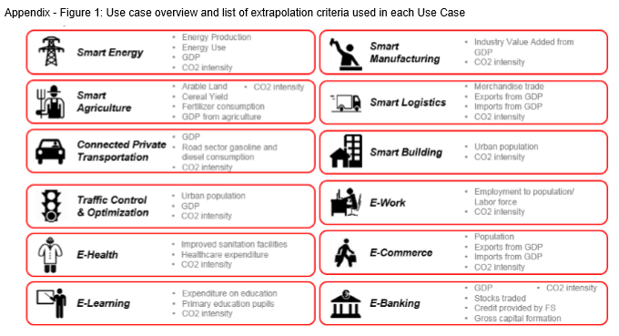
A Broad Focus in GeSI “Smarter2030”

Slide 12
A Growing Set of Net Benefits

Slide 13
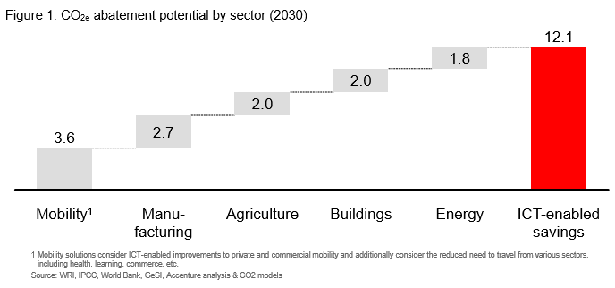
Outcomes of GeSI “Smarter2030”
Projected CO₂ 20% Savings by 2030
Source: http://smarter2030.gesi.org/downloads/Full_report.pdf

Slide 14
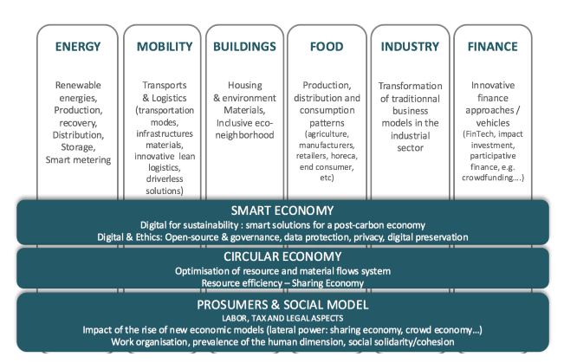
Holistic Framework Beyond Technology-Only Study
http://www.troisiemerevolutionindustrielle.lu/wp-content/uploads/2016/11/TIR-CG_Luxembourg-Final-Report_Long-Version.pdf

Slide 15
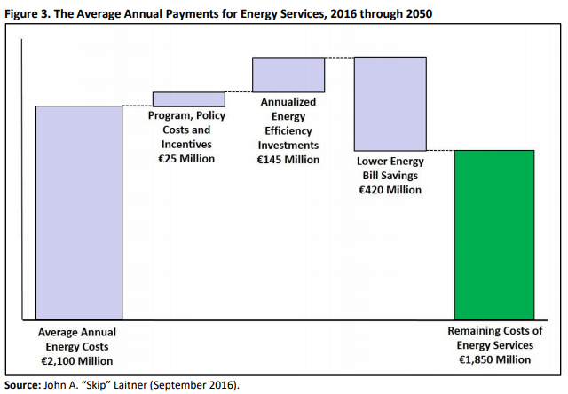
With a Scale of Effort for Luxembourg:
The Future Cost of Energy Services

Slide 16
Last Thought on the 7 Ways ICT & Energy Productivity Improve the Robustness of an Economy
It can save money and lower dependence on imported oil and reduce the potential of other supply disruptions.
It can minimize the volatility of energy and other prices.
It can lessen the threat of climate change and increase the opportunities for adaptation to shifts in climate patterns.
It can boost overall economic productivity and job creation.
It can lessen health and other environmental impacts.
It can stimulate a higher level of innovation across all sectors—increasing the prospect for a resilient, a more durable, and a more vigorous economy.
It can demonstrate a very real leadership that, in turn, may catalyze other nations to develop a similar roadmap, with synergies that amplify benefits and further reduce the risks.

Slide 17
Contact Information
John A. “Skip” Laitner (@EconSkip)
Principal Economist and Consultant
Economic and Human Dimensions Research Associates
Senior Research Economist
Russian Presidential Academy of National Economy and
Public Administration (RANEPA)
Tucson, Arizona 85750
c: (571) 332-9434
Email: EconSkip@gmail.com

